Slide 1

WELCOME
DEAR STUDENTS

Slide 2
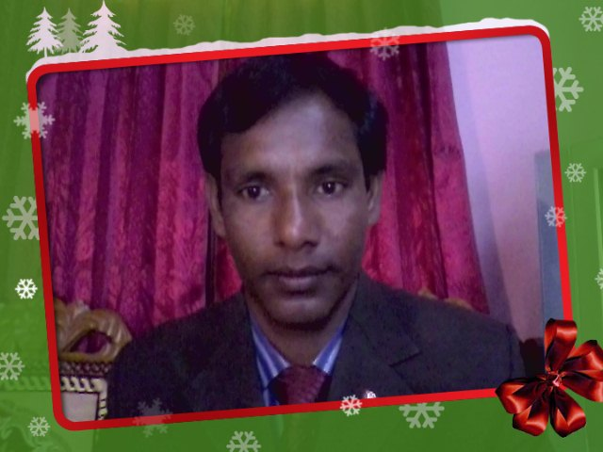
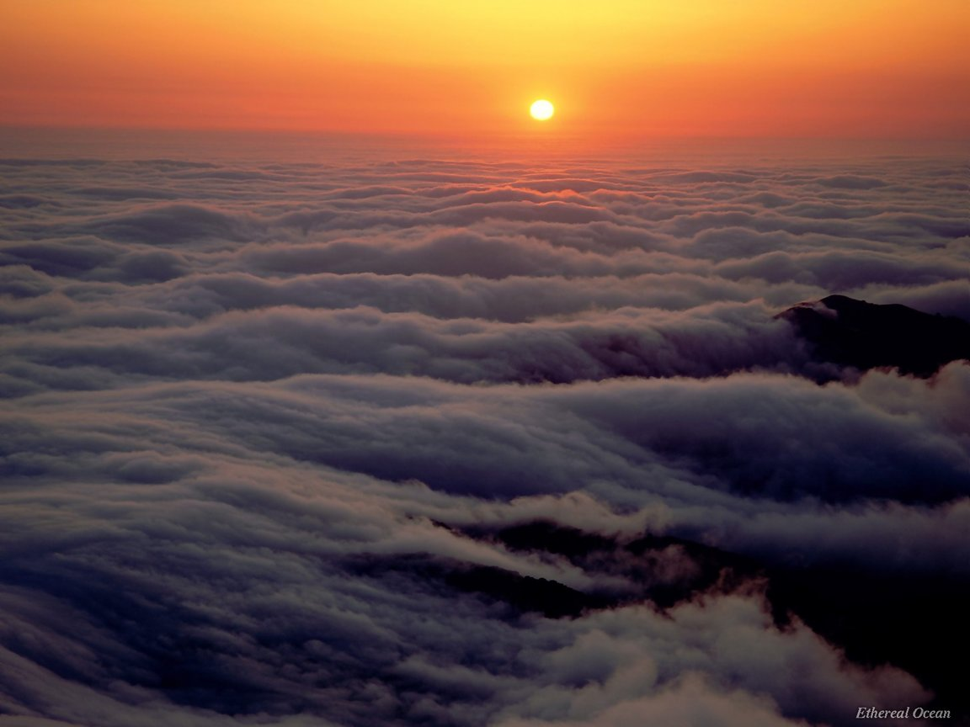
Introduction
Md Mafidulislam
English teacher
Taluksakhati High School
Kaligonj, Lalmonirhat
Email; mofidulislam094@gmail.com

Slide 3
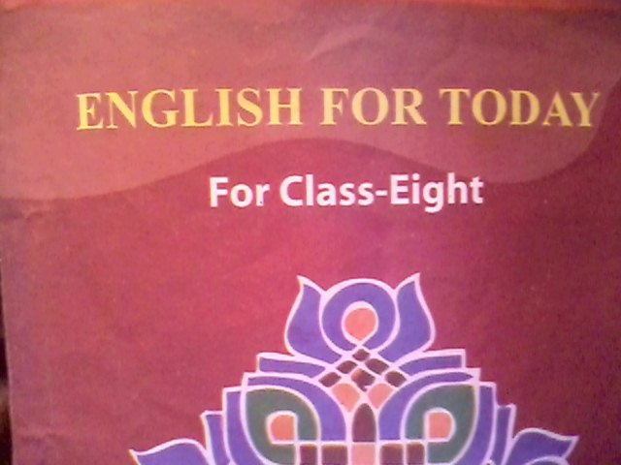
Subject;

Slide 4
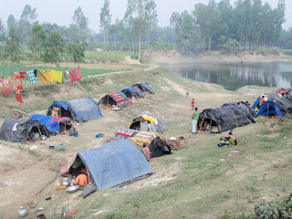

Slide 5
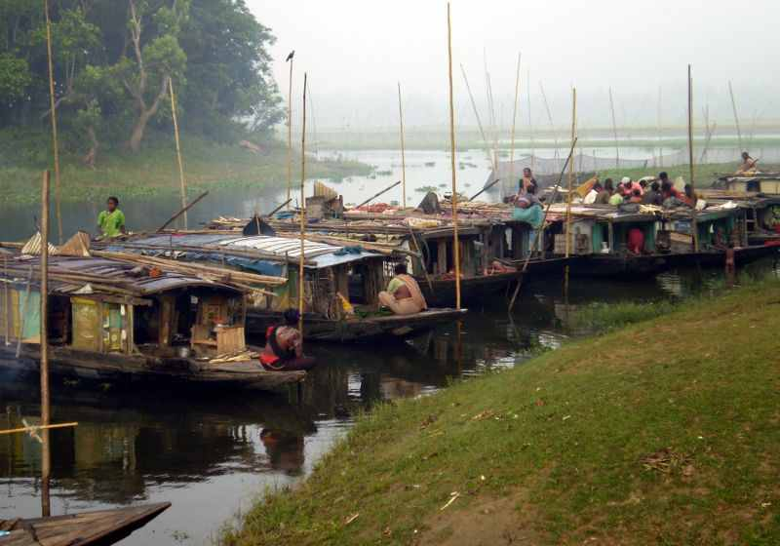

Slide 6
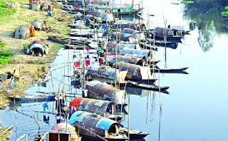

Slide 7

Topic name
Unit- seven
Lesson-3
River Gypsies in Bangladesh (1)

Slide 8

Learning outcome
By the end of the lesson Student will be able to—
Ask and answer question
Read and understand text.
Write short composition.
Vocabulary.

Slide 9

Vocabulary
Gypsy
Bedey, one of a vagabond race, nomad.
Ethnic
The first or earliest inhabitants of a country, aborigine.
Remedies
Medicine
Remote
distant
Tarpaulin
canvas

Slide 10
Read the passage carefully;
River gypsies are an ethnic group in Bangladesh. They are known as bedey to local people. The gypsies have their own lifestyle and culture.

Slide 11
In winter. Many water bodies dry up . At that time they return to the mainland and live in make –shift tarpaulin tents on open river banks. You can see their men relaxing in their tents.------

Slide 12
Fill in the blanks with suitable words from the text
remain
Throughout the monsoon, the river gypsies (a)----------busy with fishing. They also dived for natural(b)--------in waters. Sometimes, they (c)----------for a couple of weeks. Men catch (d)-------------and entertain people with snake charming and sell (e)------------cures. Women go for door to door to sell bangles, (f)-----------and other things. They also try to heal (g)----------of old people often by (h)--------------out blood from their body. Many villagers believe in the (i)-------------- ------of the gypsies. They can an (j)-------------------leave someone’s body by magic or special powers.
pearls
camp
snakes
herbal
cosmetics
pains
sucking
Magical power
Evil spirit

Slide 13

Evaluation
Give short answers to the following question
1) Who are river gypsies?
They bedeys are river gypsies.
2) How do they live ?
They live in little country boats.
3) What do river gypsies do in winter?
They live in make-shift tarpaulin tents.
4) What do river gypsy men do for a living?
They catch snakes
5) What do river gypsy women do for a living?
Women sell bangles, cosmetics and other things.

Slide 14

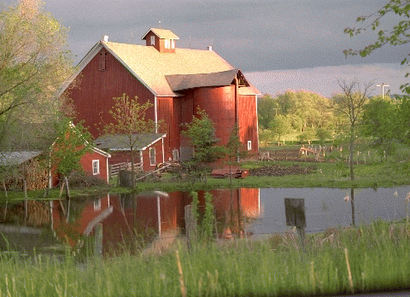
Home work
Write a paragraph based on the information about ‘The River Gypsies of Bangladesh’

Slide 15


Thank you everybody

